Slide 1


Slide 2


SMART INDIA HACKATHON 2024
Basic Details of the Team and Problem Statement
Problem Statement ID –SIH 1536.
Problem Statement Title- Student innovation.
Theme- Agriculture, foodTech and Rural Development.
PS Category- Software.
Team ID-
Team Name- Binary Wizards.

Slide 3
IDEA TITLE
Binary Wizards.
❖ We are looking for a solution by creating a Website that will serve as a platform for farmers to sell their harvests, for consumers to purchase directly from farmers, and for industrialists to buy directly from farmers, eliminating the need for middlemen.
• By accessing and utilizing location-based weather data, farmers can make precise decisions that enhance crop management, optimize resource use, and mitigate risks.
• Soil moisture sensors are valuable tools in modern farming, By providing real-time data on soil moisture levels, these sensors enable more precise water management and can lead to better crop yields and resource efficiency.
•The nearest local farmer to the customer’s location will be assigned to deliver the required goods through path optimization.
• Drones have become a transformative technology in modern agriculture, offering a range of applications that enhance efficiency, productivity, and data management.
user
Sign up/login
farmer
consumer
industrialist
Sells harvests
Purchase directly from farmer.
Buy in bulk from farmers.
Eliminating
Middlemen.

Slide 4
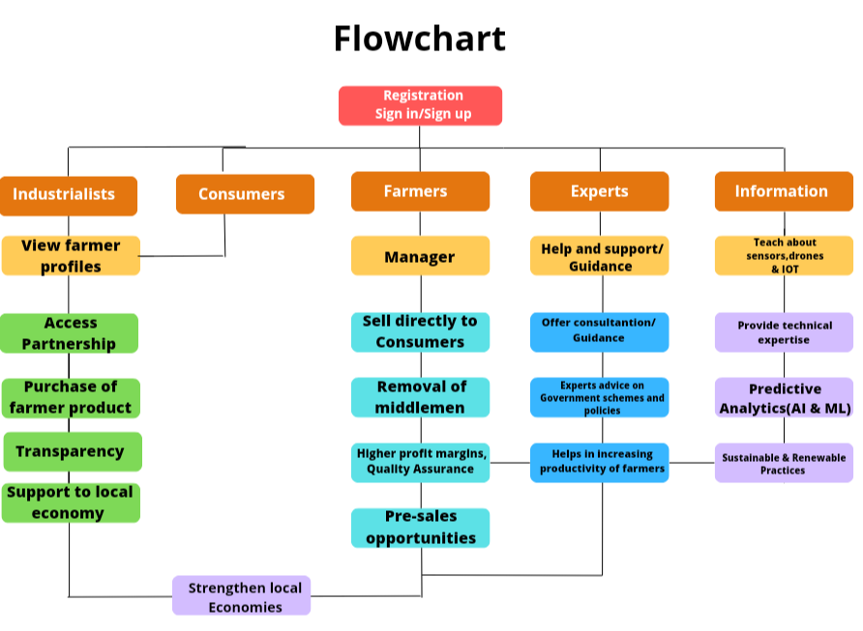
TECHNICAL APPROACH
Binary Wizards
❖A multilingual web-based platform, based on 32
Different languages, which serve the purpose of
Eliminating middlemen, and hence increase
Economic growth.
❖An AI-powered 24/7 hotline chatbot is available.
❖Algorithm development:
Next.js & Express.js- Core technologies used for
developing the OTH Algorithm.
❖Encryption and security:
Custom encryption algorithm powered by 8-layer
octa 512-bit encryption for secure data
transmission and authentication.
❖SQL-Relational database management.
Product status: 80% product built completed and
Further build is in progress. Testing and validation
Process are next to be undergone.

Slide 5
FEASIBILITY AND VIABILITY
Binary Wizards
Challenges to Consider
Infrastructure Needs: Farmers may need to invest in marketing, distribution, and customer service infrastructure.
Scalability: Managing direct sales can be labor-intensive and may require scaling strategies to handle larger volumes
Potential challenges and risks
Convincing farmers to use the platform can be difficult.
Delays or mishandling in delivery could lead to spoiled goods.
Competing with established platforms can be challenging.
Payment fraud or security breaches or delays in transaction.
Strategies for overcoming these challenges
Incentives for early adoption
Flexible delivery options
Niche Targeting
Reliable payment gateways

Slide 6
IMPACT AND BENEFITS
Binary Wizards
.
❖Removing middlemen in trading between farmers and consumers/industrialists can offer several benefits:
1. Increased Farmer Income: Farmers receive a larger share of the final sale price of their produce when selling directly to consumers or retailers, as they don’t have to share profits with intermediaries. Eliminating middlemen can lower costs related to commissions.
2. Lower Consumer Prices: Consumers often benefit from lower prices due to the absence of markups added by middlemen.
3. Enhanced Transparency: Direct interactions between farmers and consumers lead to clearer pricing structures without the added complexities of intermediary markups.
4. Promotion of Sustainable Practices:
and consumers, leading to stronger relationships and increased customer loyalty.
5. Economic and Community Benefits
6. Empowerment and Innovation
7. Promotion of Sustainable Practices
.
Direct interactions foster trust between farmers

Slide 7
RESEARCH AND REFERENCES
Binary Wizards
Details / Links of the reference and research work
Farmers Market Online
Statista Reports on E-commerce and Agriculture
McKinsey & Company Reports

